Slide 1
Time Series Analysis of Crime Data
Angela Mercy Sebasthiyan
Feb 13th 2025

Slide 2
Introduction: Objective
Analyze and predict crime trends using historical crime data.
Utilize time series forecasting models (ARIMA and SARIMA).
Provide data-driven insights for law enforcement and policymakers.

Slide 3
We will address the problem of crime trends and patterns over time. The aim is to predict future crime occurrences in different areas using time-series analysis. The client, possibly city authorities or police departments, needs this insight to allocate resources more efficiently and enhance public safety. The Project goal is Identifying seasonal and temporal trends in crime rates, and Predicting crime occurrences for future dates.
Crime management is critical for city planning, policing, and community safety. Accurate forecasts allow: Efficient officer deployment, Enhanced public awareness and safety measures, and Improved city resource allocation.
Missing or incomplete data may reduce accuracy.
Changes in crime reporting policies could skew historical data.
Real-time prediction needs may require additional resources for deployment
The solution will be successful if It improves prediction accuracy for crime trends, It provides actionable insights for decision-makers, and Performance is validated by historical data.
Stakeholders to provide key insight
City police departments and authorities.
Policy makers in public safety.
Data analysts in urban planning departments.
Scope of solution space
Time-series forecasting ARIMA, SARIMA
Data preprocessing to clean and prepare historical crime data
Feature engineering
"Crime Data from 2020 to Present." Key fields may include: Date and time of crime, Location, and Crime type.

Slide 4
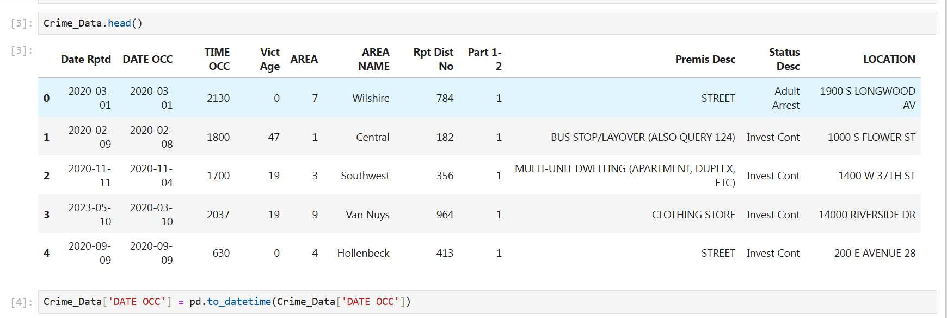
Dataset Description
Dataset Overview:
Crime incident reports from various areas.
Important Fields: DATE OCC, Vict Age, AREA NAME, Premis Desc

Slide 5
Dataset Description:
Key Features
Numerical Columns:
Date Rptd, DATE OCC, TIME OCC, Vict Age, AREA, Rpt Dist No.
Categorical Columns:
AREA NAME, Status Desc, LOCATION, Premis Desc.

Slide 6
Data Preprocessing:
Cleaning and Transformation
Removed missing and inconsistent records.
Converted date fields to datetime format.
Aggregated crime counts by reporting date.

Slide 7
Exploratory Data Analysis (EDA)
Visual Insights
Crime Trends Over Time (Time-series plot of total reported crimes per month).
Crime Distribution by Area (Bar chart of crime occurrences across different areas).

Slide 8
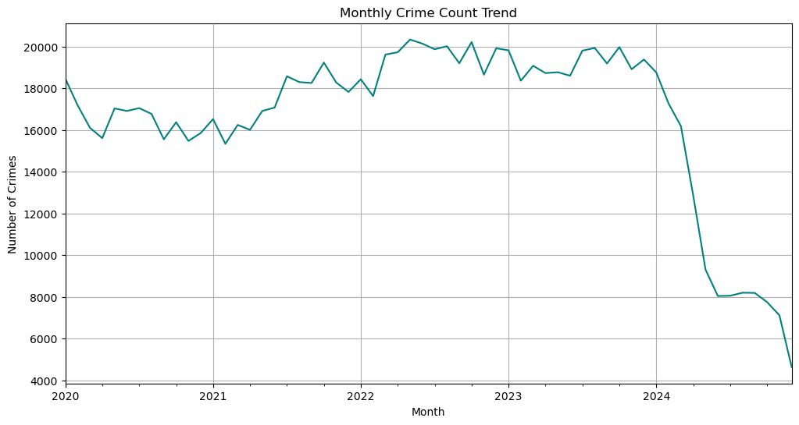
Exploratory Data Analysis (EDA)
Key Insights:
High crime frequency in certain areas.
Temporal patterns suggest daily or monthly seasonality.
Time Series Aggregation: Grouped by DATE OCC to create time series data.

Slide 9
Methodology – ARIMA
ARIMA (AutoRegressive Integrated Moving Average)
Captures crime trends via:
Autoregressive (AR) component.
Differencing (I) to remove trends.
Moving Average (MA) component.
Model selection based on ACF and PACF plots.
Optimized parameters (p, d, q) using grid search.

Slide 10
SARIMA
SARIMA (Seasonal ARIMA)
Extension of ARIMA for seasonal patterns.
Includes:
Seasonal differencing.
Seasonal autoregressive & moving average components.
Model tuned using seasonal decomposition.

Slide 11
Model Comparison
Model | RMSE | MAE | AIC
ARIMA | 245.6 | 180.3 | 2892.4
SARIMA | 198.4 | 152.7 | 2761.8
SARIMA outperforms ARIMA due to seasonality modeling.
Lower AIC indicates better model fit.

Slide 12
Training & Validation
Both ARIMA and SARIMA trained on historical data.
Evaluated on validation dataset.
Mean Absolute Error (MAE) Formula:
MAE=1n∑i=1n∣yi−y^i∣\text{MAE} = \frac{1}{n} \sum_{i=1}^{n} |y_i - \hat{y}_i|MAE=n1​∑i=1n​∣yi​−y^​i​∣
Mean Squared Error (MSE) Formula:
MSE=1n∑i=1n(yi−y^i)2\text{MSE} = \frac{1}{n} \sum_{i=1}^{n} (y_i - \hat{y}_i)^2MSE=n1​∑i=1n​(yi​−y^​i​)2

Slide 13
Key Findings:
Seasonal crime patterns observed (crime spikes during weekends/holidays).
High-crime areas: Central, Van Nuys, and Wilshire.
Peak crime hours: 6 PM to 12 AM.

Slide 14
Recommendations:
Resource Allocation: Increase police presence in high-crime areas during peak hours.
Community Engagement: Implement crime prevention programs in hotspot areas.
Further Research: Integrate external factors (weather, economy) to enhance forecasting.
Conclusion:
Demonstrated the effectiveness of time series modeling in crime forecasting.
SARIMA provided superior predictive performance.
Helps law enforcement anticipate crime trends and optimize resource allocation.

